Slide 1
Efficiently encoding term co-occurrences in inverted indexes
Date: 2012/3/5
Source: Marcus Fontouraet. al(CIKM’11)
Advisor: Jia-ling, Koh
Speaker: Jiun Jia, Chiou

Slide 2
Outline
Introduction
Indexing and query evaluation strategies
Cost function
Index construction
Query evaluation
Experimental results
Conclusion
2

Slide 3
Introduction
Precomputation of common term co-occurrences has been successfully applied to improve query performance in large scale search engines based on inverted indexes.
Inverted indexes have been successfully deployed to solve scalable retrieval problems where documents are represented as bags of terms.
Each term t is associated with a posting list, which encodes the documents that contain t.
3

Slide 4
D0 = " it is what it is "
D1 = " what is it "
D2 = " it is a banana "
Inverted Index
word | Document | Position | Frequently
" a " | Document 2
" banana " | Document 2
" is " | Document 0,1, 2
" it " | Document 0,1, 2
" what " | Document 0,1
A term search for the terms "what", "is" and "it" would give the set
{0,1}∩{0,1,2} ∩{0,1,2}={0,1}
4

Slide 5
Introduction
For a selected set of terms in the index, we store bitmaps that encode term co-occurrences.
Bitmap:
A bitmap of size k for term t augments each posting to
store the co-occurrences of t with k other terms, across
every document in the index.
Precomputed list:
typically shorter, can only be used to evaluate queries
containing all of its terms. Contains only the docids
5

Slide 6
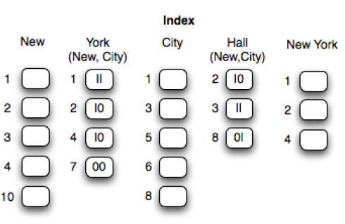
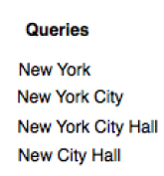
Introduction
query workload
Index with bitmaps(size=2,k=2)
for terms York and Hall
Precomputed list
chosen to represent each of these combinations by a separate posting
list, the memory cost, as well as the complexity of picking the right combinations during query evaluation, would have become prohibitive.
6
Notes:
1.New York在右方query中常出現，所以將new加入York的posting list是好的
2.由於York的posting list長度較New的posting list來的短，所以是new加到York的posting list中
3. Precomputed list 的長度相較於單一個term之posting list來得短

Slide 7
Introduction
Main Contribution:
Introduce the concept of bitmaps as a flexible way to store term co-occurrences.
Define the problem of selecting terms to precompute given a query workload and a memory budget and propose an efficient solution for it.
Show that bitmaps and precomputed lists complement each other, and that the combination significantly outperforms each technique individually.
Present experimental results over the TREC WT10g corpus demonstrating the benefits of the approach in practice.
7
Notes:
3.後面實驗會顯示Hybrid優於 bitmap和precomputed list分開的方式

Slide 8
Indexing and query evaluation strategies
Posting: 〈docid, payload〉
the occurrence of a term within a document
docid : the document identifier
Payload: used to store arbitrary information about each occurrence of term within document. And use part of the payload to store the co-occurrence bitmaps.
Basic operations on posting lists:
1. first(): returns the list's first posting
2. next(): returns the next posting or signals the end of list
3. search(d): returns the first posting with docid ≥d, or end of list if no such posting exists . This operation is typically implemented efficiently using the posting lists indexes.
8

Slide 9
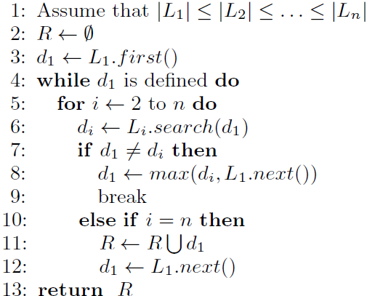
Max Successor Algorithm
conjunctive query q = t₁t_{2……} t_{n}
a search algorithm returns R
R :the set of docids of all documents that match all terms t₁t₂……t_{n}.
L₁L_{2……}L_{n} : the posting lists of terms t₁t₂……t_{n}
GOAL
checks whether the current candidate
document that match all terms from
the shortest list appears in other lists.
9
Notes:
A naive algorithm would scan L_{1,}L_{2,……}L_{n} and return the set of documents that appear in all the lists.
Clearly, the naive algorithm accesses $\sum_{i=1}^{n}{|\text{L}\text{i}|}$postings, where |L_{i}| is the number of postings in L_{i}.
※Instead of scanning over possibly numerous postings in longer lists, this step is implemented by skipping to the first position containing docid greater than or equal to the current candidate.

Slide 10
L1 L2 L3 L4 L5
Hall
New York
York
New
City
2
3
8
1
2
4
1
2
4
7
1
2
3
4
10
1
2
3
6
8
Query: “ New York City Hall ”
Result R={Document 2 ( docid=2) }
10

Slide 11


Cost function
measuring the lengths of the accessed
postings lists and the evaluation time
for each query.
Focus on Minimum cost
1) the shortest list length |L₁|
2) the random access cost 12+log|L_{i}|.
Suppose terms t₁ and t₂ frequently occur as a subquery
and |L₁| ≤ |L₂|.
11

Slide 12
L1 L2 L3 L4
Hall
York
New
City
2
3
8
1
2
4
7
1
2
3
4
10
1
2
3
6
8
Query1:“ New York ”
Query2:“ New York City ”
Query3:“ New York City Hall ”
Query4:“ New City Hall ”
F(q1)=4*[(12+log4)+(12+log5)]
F(q2)=4*[(12+log4)+(12+log5)+(12+log5)]
F(q3)=3*[(12+log3)+(12+log4)+(12+log5)+(12=log5)]
F(q4)=3*[(12+log3)+(12+log5)+(12=log5)]
12

Slide 13
Cost function(optimizing)
Precomputed List:
store the co-occurrences of t₁t₂ as a new term t₁₂ .
The size of t₁₂ 's list is exactly |L₁∩L₂|.
Advantage:
(1)Reduce the number of posting lists accessed during query evaluation
(2)Reduce the size of these lists
Bitmaps:
add a bit to the payload of each posting in L₁ . value of the bit is 1: document contains t₂ , 0: otherwise . ➔allows the query evaluation algorithm to avoid accessing L₂
Cutting the second component of the cost function
13

Slide 14
Index construction
Bitmap:
the extra space required for adding a bitmap for term t_{j} to term t_{i}'s list is exactly |L_{i}| since every posting in L_{i} grows by one bit.
EX:
term | New,York,City
 | |L_{New}| ≥ |L_{City}| ≥ |L_{York}|
queries | New York , City York , New York City
Case 1:no previous bitmaps exist
If adding a bitmap for term New to City's posting list.
improves the evaluation of query New York City
| L_{York} |(G(| L_{New}|) + G(| L_{City}|)) → | L_{York} |G(| L_{City} |)
Case 2:the list York already has bits for terms New and City
total latency would be |L_{York}|
Define : B←association matrix
Ex: b_{ij} =1 if there is a bit for term t_{j} in list L_{i} 's bitmap.
b_{City New}= 1 in the example above.
14
Notes:
1.the central question is which bitmaps and precomputed lists should be added to the index to reduce the expected latency under the given query load.
2. we face a tension between the improvement in latency caused by using precomputed objects (whether bitmaps or precomputed lists) and the extra space required for precomputed results.

Slide 15
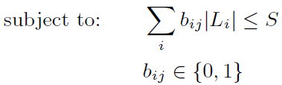

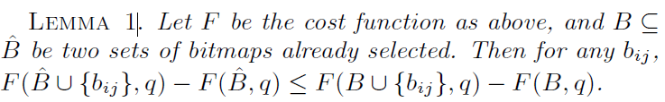

Given a set of bitmaps B and a query q F(B,q) :the latency of evaluating q with the bitmaps indicated by B. S: the total space available for storing extra information Q = {q₁, q_{2,} …….} the query workload.
1.Consider the benefit of an extra bitmap,b_{ij}, when a previous set B has
already been selected. This is exactly F(B ∪{b_{ij}},q) - F(B,q).
2. ⊇ B has already been selected,( ∪{b_{ij}},q) - F( , q).
computes the ratio of the benefit
to the increase in index size
15
Notes:
Then b_{ij} with the maximum λ_{ij} is selected as the next bitmap to be added, and the benefit ratios λ_{ij} are recomputed.
Lemma 1:欲說明考慮posting list越少(index size較小)的B集合，當加入一個新的bitmap，其新的latency較原始latency差距較大。adding an element to a smaller set helps more than adding it to a larger set

Slide 16
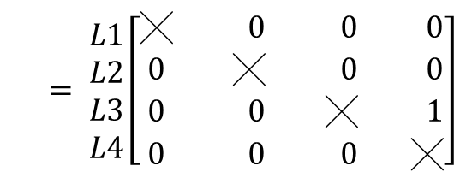
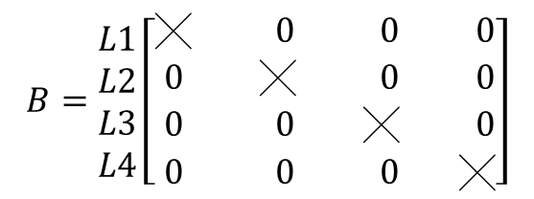


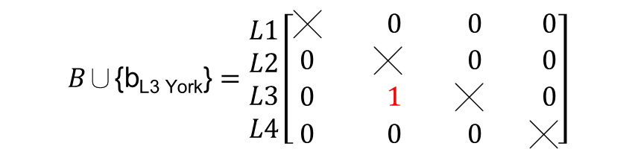



$$\begin{matrix}Hall & York & New & City\end{matrix}$$
$$\begin{matrix}Hall & York & New & City\end{matrix}$$
$$B=\begin{matrix}L1 \\ L2 \\ L3 \\ L4\end{matrix}\left[\begin{matrix}\text{╳} & 0 & 0 & 0 \\ 0 & \text{╳} & 0 & 0 \\ 0 & 0 & \text{╳} & 0 \\ 0 & 0 & 0 & \text{╳}\end{matrix}\right]$$
$$B\text{∪\{}\text{bL}\text{3 }\text{York}\text{\}}=\begin{matrix}L1 \\ L2 \\ L3 \\ L4\end{matrix}\left[\begin{matrix}\text{╳} & 0 & 0 & 0 \\ 0 & \text{╳} & 0 & 0 \\ 0 & 1 & \text{╳} & 0 \\ 0 & 0 & 0 & \text{╳}\end{matrix}\right]$$
(bit)
B:L_{new}+York
B:L_{new}
$$\begin{matrix}Hall & York & New & City\end{matrix}$$
$$\begin{matrix}Hall & York & New & City\end{matrix}$$
$= \begin{matrix}L1 \\ L2 \\ L3 \\ L4\end{matrix}\left[\begin{matrix}\text{╳} & 0 & 0 & 0 \\ 0 & \text{╳} & 0 & 0 \\ 0 & 0 & \text{╳} & 1 \\ 0 & 0 & 0 & \text{╳}\end{matrix}\right]$
$$\text{∪\{}\text{bL}\text{3 }\text{York}\text{\}}=\begin{matrix}L1 \\ L2 \\ L3 \\ L4\end{matrix}\left[\begin{matrix}\text{╳} & 0 & 0 & 0 \\ 0 & \text{╳} & 0 & 0 \\ 0 & 1 & \text{╳} & 1 \\ 0 & 0 & 0 & \text{╳}\end{matrix}\right]$$
(bit)
B:L_{new}+City
(bit) (bit)
B:L_{new}+City+York
L1: Hall’s posting list
L2: York’s posting list
L3: New’s posting list
L4: City’s posting list
16

Slide 17
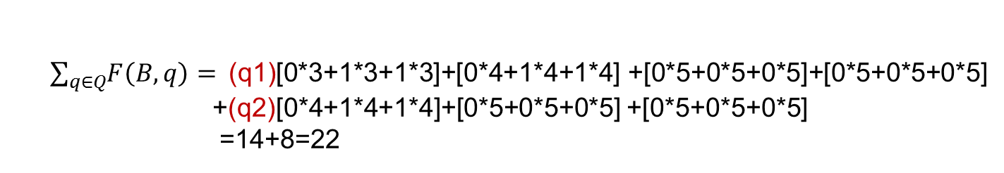

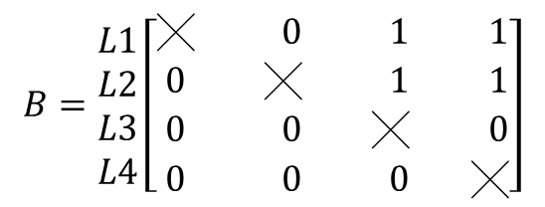
L1 L2 L3 L4
Hall
{New,City}
York
{New,City}
New
City
2
3
8
10
1
2
4
7
11
1
2
3
4
10
1
2
3
6
8
11
10
01
10
$$\begin{matrix}Hall & York & New & City\end{matrix}$$
00
$$B=\begin{matrix}L1 \\ L2 \\ L3 \\ L4\end{matrix}\left[\begin{matrix}\text{╳} & 0 & 1 & 1 \\ 0 & \text{╳} & 1 & 1 \\ 0 & 0 & \text{╳} & 0 \\ 0 & 0 & 0 & \text{╳}\end{matrix}\right]$$
Query(q1):“ New York City Hall“
Query(q2):“ New York City“
$\sum_{q∈Q}{\left.F\left(B,q\right)=\right.}$(q1)[0*3+1*3+1*3]+[0*4+1*4+1*4] +[0*5+0*5+0*5]+[0*5+0*5+0*5]
+(q2)[0*4+1*4+1*4]+[0*5+0*5+0*5] +[0*5+0*5+0*5]
=14+8=22
17

Slide 18
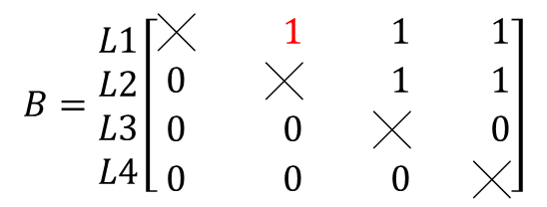
L1 L2 L3 L4
Hall
{New,City,York}
York
{New,City}
New
City
2
3
8
101
1
2
4
7
11
1
2
3
4
10
1
2
3
6
8
110
10
011
10
$$\begin{matrix}Hall & York & New & City\end{matrix}$$
00
$$B=\begin{matrix}L1 \\ L2 \\ L3 \\ L4\end{matrix}\left[\begin{matrix}\text{╳} & 1 & 1 & 1 \\ 0 & \text{╳} & 1 & 1 \\ 0 & 0 & \text{╳} & 0 \\ 0 & 0 & 0 & \text{╳}\end{matrix}\right]$$
Query(q1):“ New York City Hall“
Query(q2):“ New York City“
F(B∪{b_{L1York}},q1) = 3(7)
F(B∪{b_{L1York}},q2) = 3(3)
λ_{L1York} = [(7-3)+(3-3)]/3=4/3
18

Slide 19
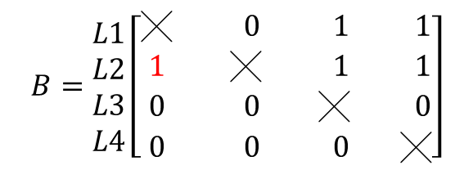
L1 L2 L3 L4
Hall
{New,City}
York
{New,City,Hall}
New
City
2
3
8
10
1
2
4
7
111
1
2
3
4
10
1
2
3
6
8
11
101
01
100
$$\begin{matrix}Hall & York & New & City\end{matrix}$$
001
$$B=\begin{matrix}L1 \\ L2 \\ L3 \\ L4\end{matrix}\left[\begin{matrix}\text{╳} & 0 & 1 & 1 \\ 1 & \text{╳} & 1 & 1 \\ 0 & 0 & \text{╳} & 0 \\ 0 & 0 & 0 & \text{╳}\end{matrix}\right]$$
Query(q1):“ New York City Hall“
Query(q2):“ New York City“
F(B∪{b_{L2 Hall}},q1) = 4(7)
F(B∪{b_{L2 Hall}},q2) = 4(4)
λ_{L2 Hall} = [(7-4)+(4-4)]/4=3/4
19

Slide 20
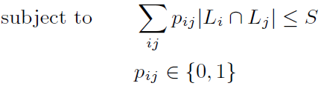


Index construction
Precomputed lists:
Given a set of precomputed lists P = {p}_{ij} , where p_{ij} is the indicator variable representing whether the results of query t_{i}t_{j} were precomputed
F(P,q) : the cost of evaluating query q given P
Adding an extra precomputed list p to P can obviously only reduce F, but at the cost of storing a new list of size | L_{i} ∩ L_{j} |.
select the precomputed list p_{ij} that maximizes λ’_{ij}
20
Notes:
1. precomputed lists can encode conjunctions of more than two terms, the utility of precomputed lists drops sharply with each new term,
as the list requires that all of the terms be present in the query.
2. found that in the AOL query log the 100 most frequent three-term conjunctions appear in only one quarter of the 100 most frequent
two-term conjunctions.
3. since the number of possible multi-term conjunctions grows exponentially with the number of terms in a query, considering them during index construction and during query evaluation becomes computationally expensive. We thus consider only precomputed lists of two terms that capture most of the benefit of such lists.

Slide 21

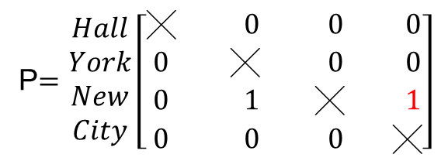
L1 L2 L3 L4
New City
New York
Hall
York
New
City
1
2
3
1
2
4
2
3
8
1
2
4
7
1
2
3
4
10
1
2
3
6
8
Query(q1):“ New York City Hall“
Query(q2):“ New York City“
Query(q3):“ New City Hall ”
$$\begin{matrix} Hall & York & New & City\end{matrix}$$
P$=\begin{matrix}Hall \\ York \\ New \\ City\end{matrix}\left[\begin{matrix}\text{╳} & 0 & 0 & 0 \\ 0 & \text{╳} & 0 & 0 \\ 0 & 1 & \text{╳} & 1 \\ 0 & 0 & 0 & \text{╳}\end{matrix}\right]$
F(P∪{p_{NewCity}},q1) = 3*[(12+log3)+(12+log3)]
F(P∪{p_{NewCity}},q2) = 3*[(12+log3)]
F(P∪{p_{NewCity}},q3) = 3*[(12+log3)]
λ‘_{New City} = [(3log5-3log3)+(3log5-3log3)+(3log5-log3)]/3
21
Notes:
New & Yorks’posting lists have same document:1、2、4

Slide 22
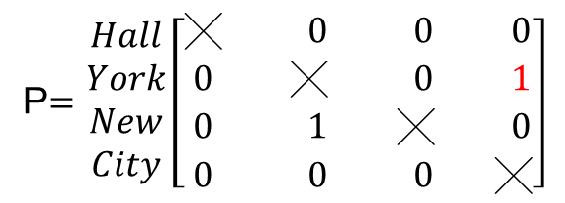
L1 L2 L3 L4
York City
New York
Hall
York
New
City
1
2
1
2
4
2
3
8
1
2
4
7
1
2
3
4
10
1
2
3
6
8
Query(q1):“ New York City Hall“
Query(q2):“ New York City“
Query(q3):“ New City Hall ”
$$\begin{matrix} Hall & York & New & City\end{matrix}$$
P$=\begin{matrix}Hall \\ York \\ New \\ City\end{matrix}\left[\begin{matrix}\text{╳} & 0 & 0 & 0 \\ 0 & \text{╳} & 0 & 1 \\ 0 & 1 & \text{╳} & 0 \\ 0 & 0 & 0 & \text{╳}\end{matrix}\right]$
F(P∪{p_{NewCity}},q1) = 2*[(12+log3)+(12+log3)]
F(P∪{p_{NewCity}},q2) = 2*[(12+log3)]
F(P∪{p_{NewCity}},q3) = 2*[(12+log3)+(12+log3)]
λ‘_{York City} = [(24-log3+3log5)+(12-2log3+3log5)+(3log5-log3)]/2
22

Slide 23
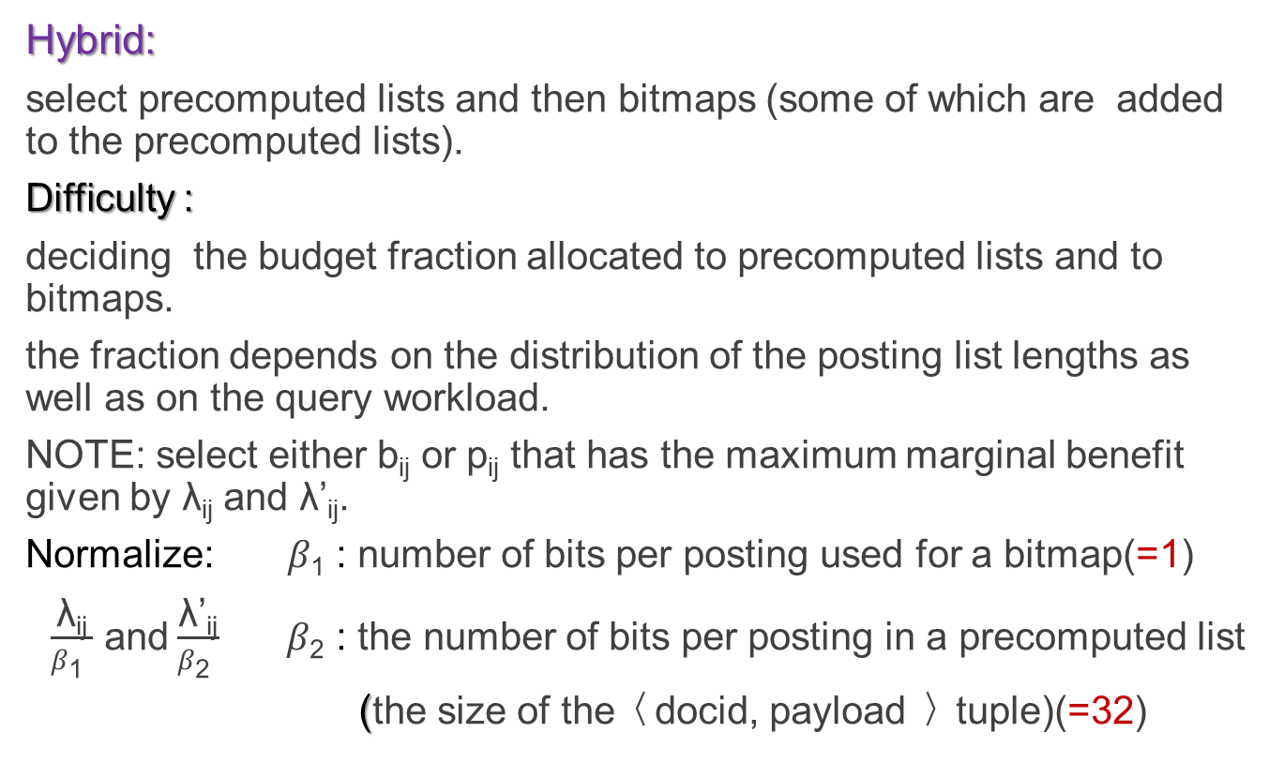
Index construction
Hybrid:
select precomputed lists and then bitmaps (some of which are added to the precomputed lists).
Difficulty :
deciding the budget fraction allocated to precomputed lists and to bitmaps.
the fraction depends on the distribution of the posting list lengths as well as on the query workload.
NOTE: select either b_{ij} or p_{ij} that has the maximum marginal benefit given by λ_{ij} and λ’_{ij}.
Normalize: $β\text{1}$: number of bits per posting used for a bitmap(=1)
$\frac{\text{λ}\text{ij}}{β\text{1} }$ and$\frac{\text{λ}\text{’}\text{ij}}{β\text{2} } β\text{2}$ : the number of bits per posting in a precomputed list
(the size of the〈docid, payload 〉tuple)(=32)
23
Notes:
Note: cannot solve the optimization problem for selecting both bitmaps and precomputed list as above. The difficulty arises from the fact that while precomputed lists can carry bitmaps, we can only add bitmaps to the precomputed lists that are already selected. That is, the benefit of adding a bitmap to a precomputed list increases (becomes positive) after adding that precomputed list

Slide 24
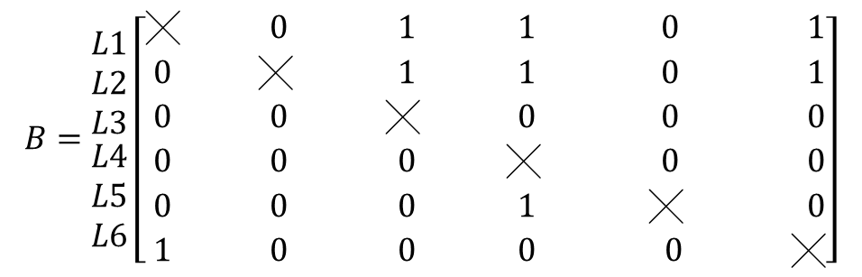
L6 L5 L1 L2 L3 L4
New City
{Hall}
New York
{City}
Hall
{New,City}
York
{New,City}
New
City
1
2
3
1
2
4
1
2
3
8
10
1
2
4
7
11
1
2
3
4
10
1
2
3
6
8
0
11
10
0
01
10
00
Query(q1):“ New York City Hall“
Query(q2):“ New York City“
Query(q3):“ New City Hall ”
F(P∪{p_{NewCity}},q1) = 3*[(12+log3)+(12+log3)]
F(P∪{p_{NewCity}},q2) = 3*[(12+log3)]
F(P∪{p_{NewCity}},q3) = 3*[(12+log3)]
λ‘_{New City} =
[(3log5-3log3)+(3log5-3log3)+(3log5-log3)]/3
Normalize: λ‘_{New City} /32
$$\begin{matrix}Hall & York & New & City New_York New_City\end{matrix}$$
$$B=\begin{matrix}L1 \\ L2 \\ L3 \\ \begin{aligned}L4 \\ L5 \\ L6\end{aligned}\end{matrix}\left[\begin{matrix}\text{╳} & 0 & 1 & 1 & 0 & 1 \\ 0 & \text{╳} & 1 & 1 & 0 & 1 \\ 0 & 0 & \text{╳} & 0 & 0 & 0 \\ 0 & 0 & 0 & \text{╳} & 0 & 0 \\ 0 & 0 & 0 & 1 & \text{╳} & 0 \\ 1 & 0 & 0 & 0 & 0 & \text{╳}\end{matrix}\right]$$
24

Slide 25
L6 L5 L1 L2 L3 L4
New City
{Hall}
New York
{City}
Hall
{New,City}
York
{New,City}
New
City
1
2
3
1
2
4
1
2
3
8
10
1
2
4
7
11
1
2
3
4
10
1
2
3
6
8
0
11
10
0
01
10
00
Query(q1):“ New York City Hall“
Query(q2):“ New York City“
Query(q3):“ New City Hall ”
F(B∪{b_{L6 Hall}},q1) = 3+3=6(6)
F(B∪{b_{L6Hall}},q2) = 3(3)
F(B∪{b_{L6Hall}},q3) = 3(6)
λ_{L6 Hall} = [(6-6)+(3-3)+(6-3)]/3=1
Normalize:1/1=1
25

Slide 26
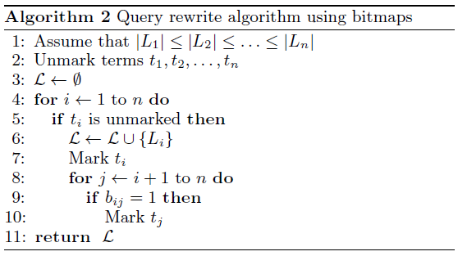
Query evaluation
Bitmap:
Goal: find a subset of the lists that minimizes the query cost
find L that covers q and minimizes F(B,q).
L ⊆ {L₁,L₂, …………… ,L_{n}}
L covers the query q ↔
26
Notes:
iff條件: 對於query所有的terms(term i)，存在著一個posting list中含有term i或是存在著term i本身的posting list
If a given list L is unmarked, it is marked and added to L. The algorithm then checks to see if any of the longer unmarked lists are present in the bitmap of L (and can hence be evaluated using only the information in L). It marks all of the lists that satisfy this condition and continues with the next longest unmarked list.

Slide 27
L1 L2 L3 L4
New
York
{New,City}
City
Hall
{New,City}
2
3
8
1
2
4
7
1
2
3
4
10
1
2
3
6
8
Query: “ New York City Hall ”
i | L set | Mark(term) | Unmark(term)
1(New) | {L1} | New | York,City,Hall
2(York) | {L1,L2} | New,York,City | Hall
3(City) | {L1,L2} | New,York,City | Hall
4 (Hall) | {L1,L2,L4} | New,York,City,Hall
27

Slide 28
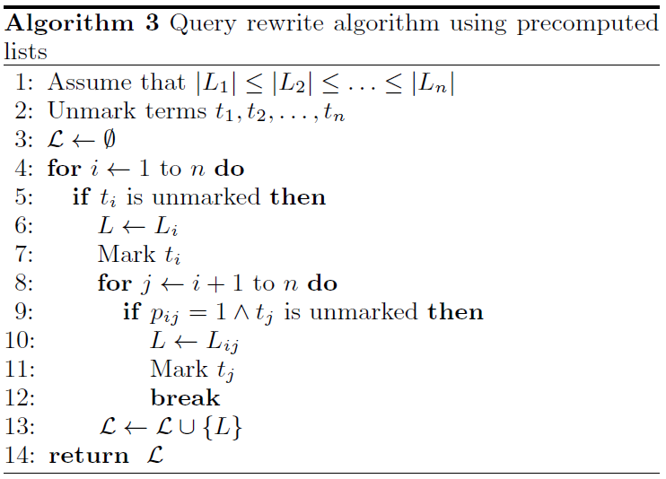
Query evaluation
Precomputed lists:
Goal: find the set of lists that minimize the cost function and
jointly cover all of the query terms.
28

Slide 29

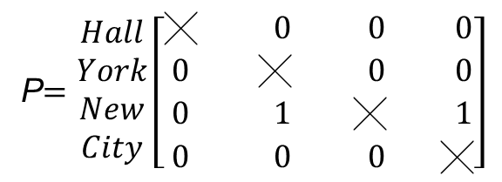
L1 L3 L4 L5
New City
New York
New
York
{New,City}
City
Hall
{New,City}
2
3
2
2
3
8
1
2
4
7
1
2
3
4
10
1
2
3
6
8
Query: “ New York City Hall ”
i | L set | Mark(term) | Unmark
1(New) | {L_{New，}L_{New York，}L_{New City} } | New,York,City | Hall
2(York) | {L_{New，}L_{New York} ，L_{New City} } | New,York,City | Hall
3(City) | {L_{New，}L_{New York} ，L_{New City} } | New,York,City | Hall
4 (Hall) | {L_{New，}L_{New York} ，L_{New City，}L_{Hall}} | New,York,City,Hall
$$\begin{matrix} Hall & York & New & City\end{matrix}$$
P$=\begin{matrix}Hall \\ York \\ New \\ City\end{matrix}\left[\begin{matrix}\text{╳} & 0 & 0 & 0 \\ 0 & \text{╳} & 0 & 0 \\ 0 & 1 & \text{╳} & 1 \\ 0 & 0 & 0 & \text{╳}\end{matrix}\right]$
29

Slide 30
Query evaluation
Hybrid:
invokes Algorithm 3 to identify precomputed lists →minimizing |L₁|
invokes Algorithm 2 for removing some of these lists that are covered by bitmaps in shorter lists.
30

Slide 31
Experimental results
Report in memory list access latencies measured after query rewrite and after preloading all posting lists into memory, averaged over several runs.
Indexed the TREC WT10g corpus consisting of 1.68 million web pages.
Built an inverted index where each posting contains a docid of four bytes and variable size payload containing bitmaps.
Used the AOL query log and sorted all of the queries according to their timestamps and discarded queries containing non-alphanumeric characters, as well as all additional information contained in the log beyond query strings.
31

Slide 32
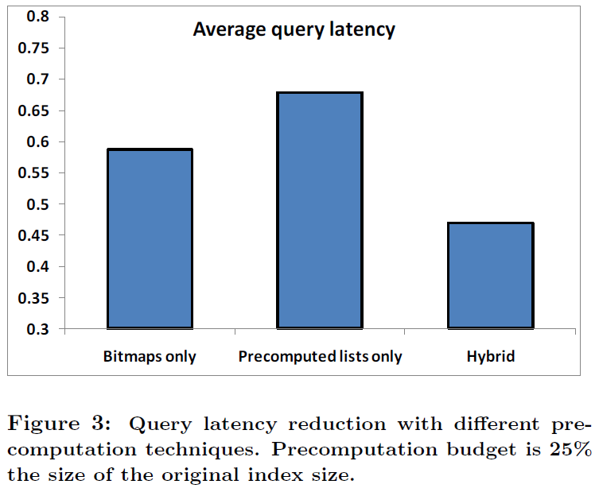
Experimental results
The resulting 23.6M queries were split into training and testing sets.
Training sets : 21M queries from the AOL log, spanning 2.5 months.
Testing sets : 2.6M queries, spanning the following two weeks.
32%
The ratio between the average query latency when using the index with precomputed results and the average latency using the original index
53%
32
Notes:
baseline reduces the average query latency by 32% while the bitmap precomputation technique we propose by 41%. A combination of the two techniques achieves an even better result of 53% latency reduction.

Slide 33
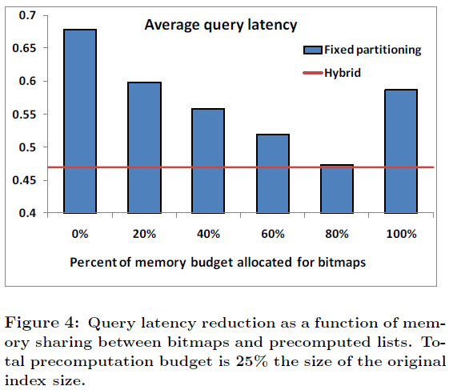
Experimental results
evaluated two strategies of allocating a shared
memory budget for bitmaps and precomputed lists:
Allocating a fixed fraction of memory budget for bitmaps and precomputed
lists, first selecting precomputed lists and then bitmaps.
(2) bitmaps and precomputed lists simultaneously using the hybrid.
The ratio between the average query latency when using the index with precomputed results and the average latency using the original index.
33
Notes:
※0%: 只使用Precomputed list 、20%: 1/5給bitmap 剩下給Precomputed list、100%:只用用bitmap

Slide 34

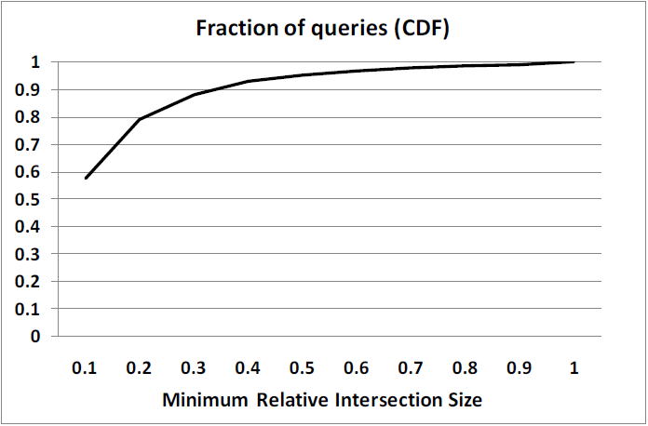
Minimum relative intersection size(MRIS)
Define: (For each query of at least two terms)
the relative size of the shortest list resulting from an intersection
of two query terms to the shortest list of a single term
MRIS captures the potential benefit of adding the optimal precomputed list of two terms for this particular query.
34
Notes:
MRIS lower,the lower evaluation cost can be achieved, the lower is the storage cost of that precomputed list.

Slide 35
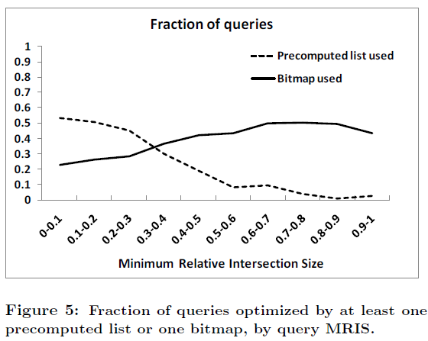
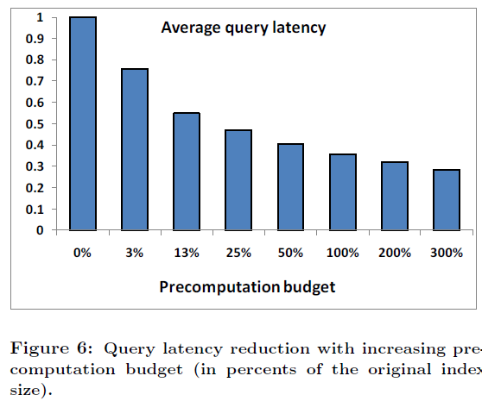
the average query latency as a function
of the precomputation budget
0.75
0.33
from 0%
(the original index without precomputation)
to 300%
(precomputed results occupy 3/4 of the index)
35
Notes:
圖ㄧ:shows that while queries with low MRIS are effectively optimized using precomputed lists, as MRIS increases their effectiveness drops to almost zero. The effectiveness of bitmaps, on the other hand, is independent of the MRIS, thus their marginal benefit (captured by the hybrid algorithm) rises with MRIS.
圖二:evaluate the marginal benefit of allocating memory for precomputed results using the hybrid
allocating as little as 3% of additional memory for precomputed results decreases average query latency by 25%. As the index grows to twice the original size, the latency decreases by almost 2/3.

Slide 36
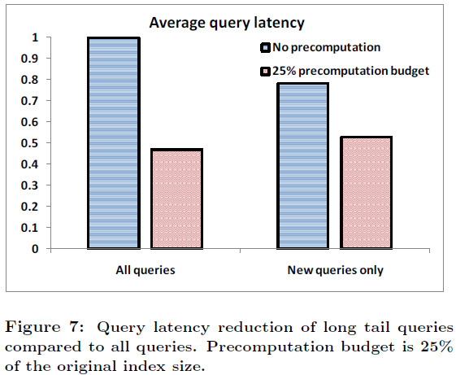
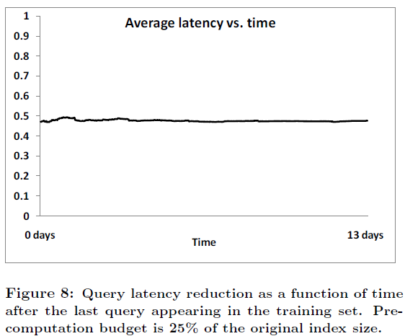
Experimental results
Evaluate the effect of precomputation on long tail queries
All queries in the test set that did not appear in the training set
the latency of all queries and compares it to that of the long tail queries, with and without precomputation
22%
33%
36
Notes:
1.without precomputation the average latency of long tail queries is lower by 22% than the average latency of all queries, since the posting lists of terms in long tail queries tend to be shorter than average. This could possibly happen due to higher fraction of rare terms (e.g., names, foreign words, misspellings) in these queries.
2. precomputation reduces their average latency by 33%.
3. Figure 8 shows that the average latency does not change, indicating that in this timeframe,while the query mix might change, the common subqueries stay the same and thus there is no degradation in performance.

Slide 37
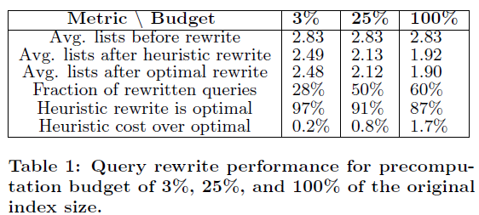
Experimental results
Query rewrite performance
Evaluate how well the greedy query rewrite algorithm performs compared to the optimal
the optimal query rewrite by evaluating our cost function on all possible rewrites given the index and selecting the one with the lowest cost.
37
Notes:
1. the precomputation budget increases, the quality of our heuristic approximation goes down, albeit only slightly.
2. Even when half of the index contains precomputed results, the evaluation cost due to heuristic approximation is only two percent
higher than with the optimal rewrite.

Slide 38
Conclusion
Introduced the concept of bitmaps for optimizing query evaluation over inverted indexes.
Bitmaps allow for a flexible way of storing information about term co-occurrences and complement the traditional approach of precomputed lists.
Proposed a greedy procedure for the problem of selecting bitmaps and precomputed lists that is a constant approximation to the optimal algorithm.
The analysis of bitmaps and precomputed lists over the TREC WT10g corpus shows that the hybrid approach achieves 25% query performance improvement for 3% growth in index size and 71% for 4-fold index size increase.
38

Slide 39
Thank you
for your listening !
39

